Slide 1
Ch 2: Human Visual System and Image Perception From Computer Science perspective...
Fatoş T. Yarman Vural
Hazal Moğultay

Slide 2
How do we perceive the physical world?
‘Let there be light! ‘

Slide 3
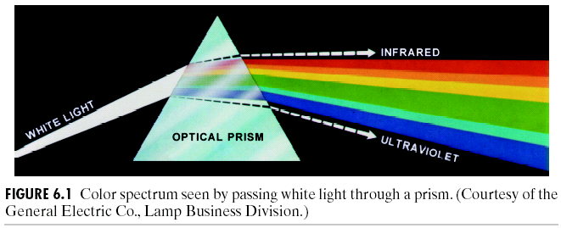
Image Perception
“Let Newton be! And all was light”” Alexander Pope

Slide 4
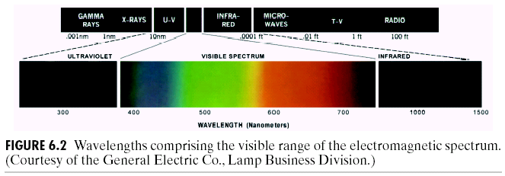
ELECTROMAGNETIC SPECTRUM AND VISIBLE BAND
Can perceive 7% of the entire electromagnetic spectrum

Slide 5
Human Visual System: Eye-Brain Channel
Visible light
eye
brain
World model
Low level
Acquisition
Sampling
Quantization
Enhancement
Compression
High Level
Enhancement +
Compression+
Segmentation
Feature Extraction
Representation
Labeling
Understanding

Slide 6
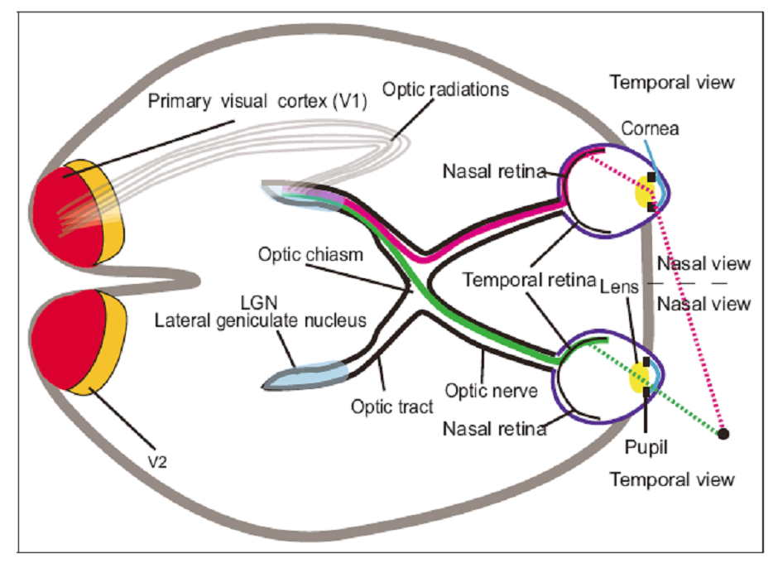
Eye-brain channel

Slide 7
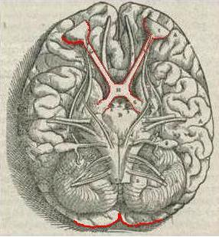
Eye-Brain Channel
Lateral Geniculate Nucleus
Primary Visual Cortex

Slide 8
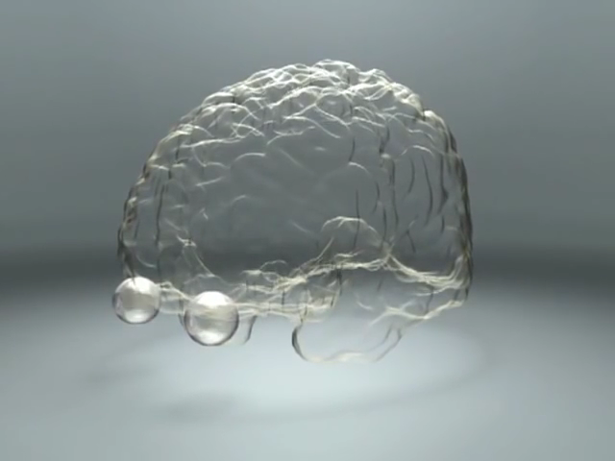
What and where pathways

Slide 9
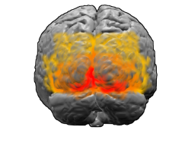
http://neuro.ceng.metu.edu.tr/fmri_prj/animations.html
In the Brain (60-70% is for vision)

Slide 10
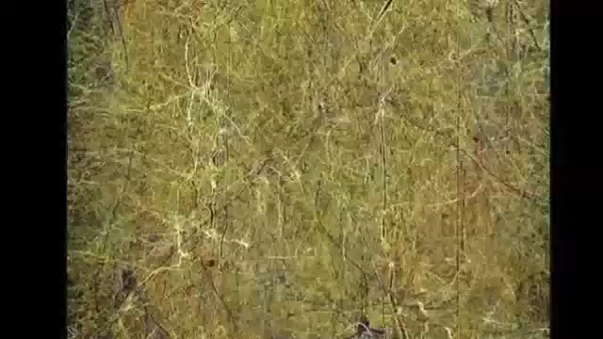
In the Brain: We create the model of the object
Brain in a Supercomputer

Slide 11
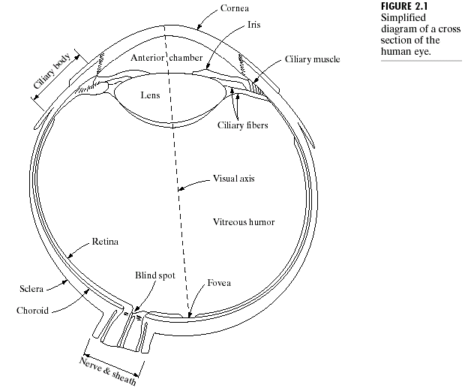
EYE: A Feedback Control System:
Adjusts the diameter of
Eye ball
Pupil
Lenz
Diameter:20mm
Pupil 2mm
Fovea: Sensors,rodes and cones

Slide 12
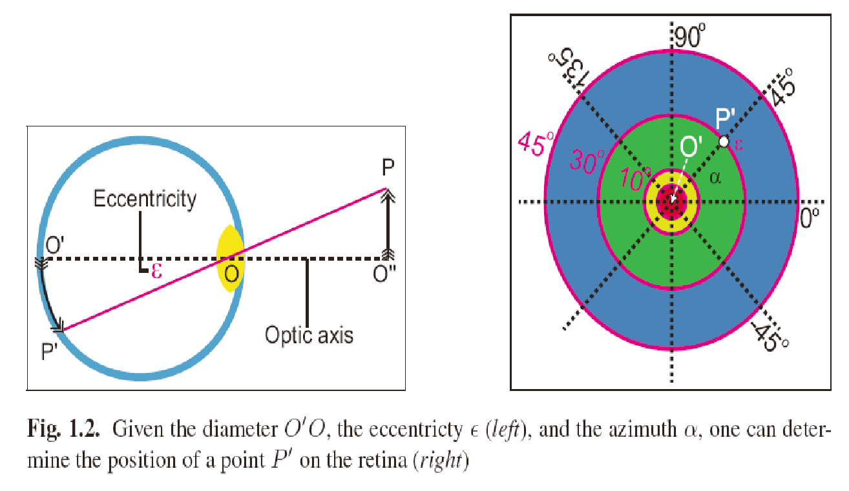
The Eye Ball: Photo-receptors are Scattered on Retina

Slide 13
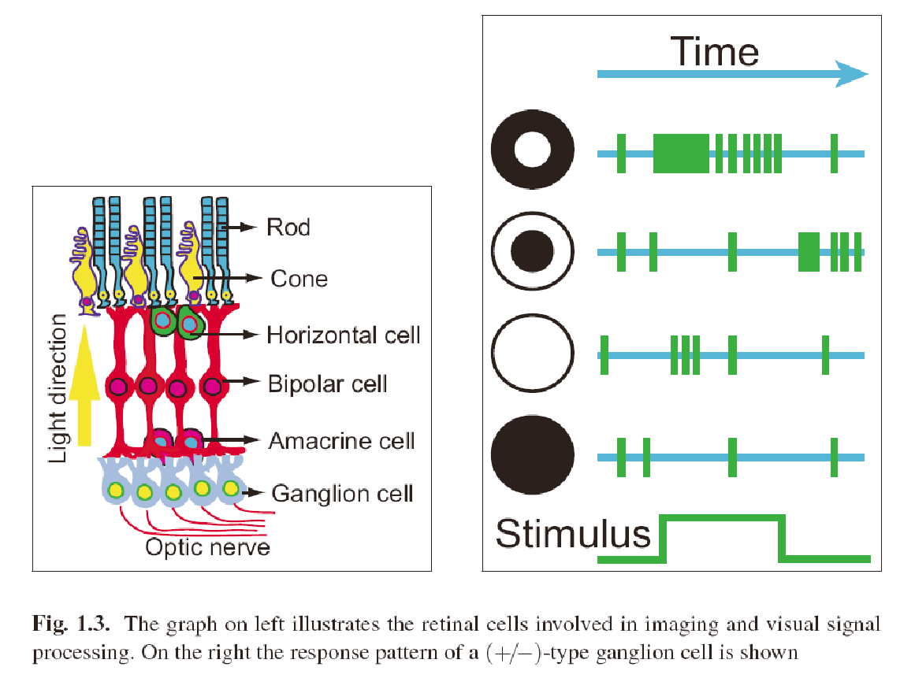
Photoreceptors: On the retina
Rodes
Cones

Slide 14
Sampling and Quantization Around the Fovea
Cones: 6-7 million, located mostly on fovea, sensitive to color, each one is connected to a nerve cell
Rodes:75-150 million, distributed over retina, sensitive to shape info, several of them are connected to the same nerve cell

Slide 15
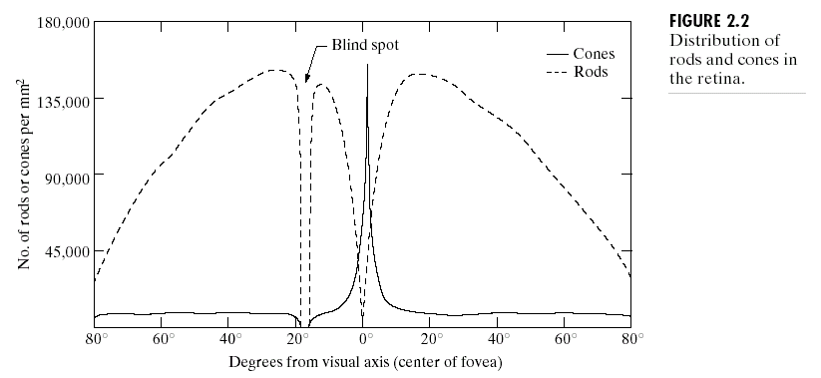
RODES:
80-100 Million for Shape Perception

Slide 16
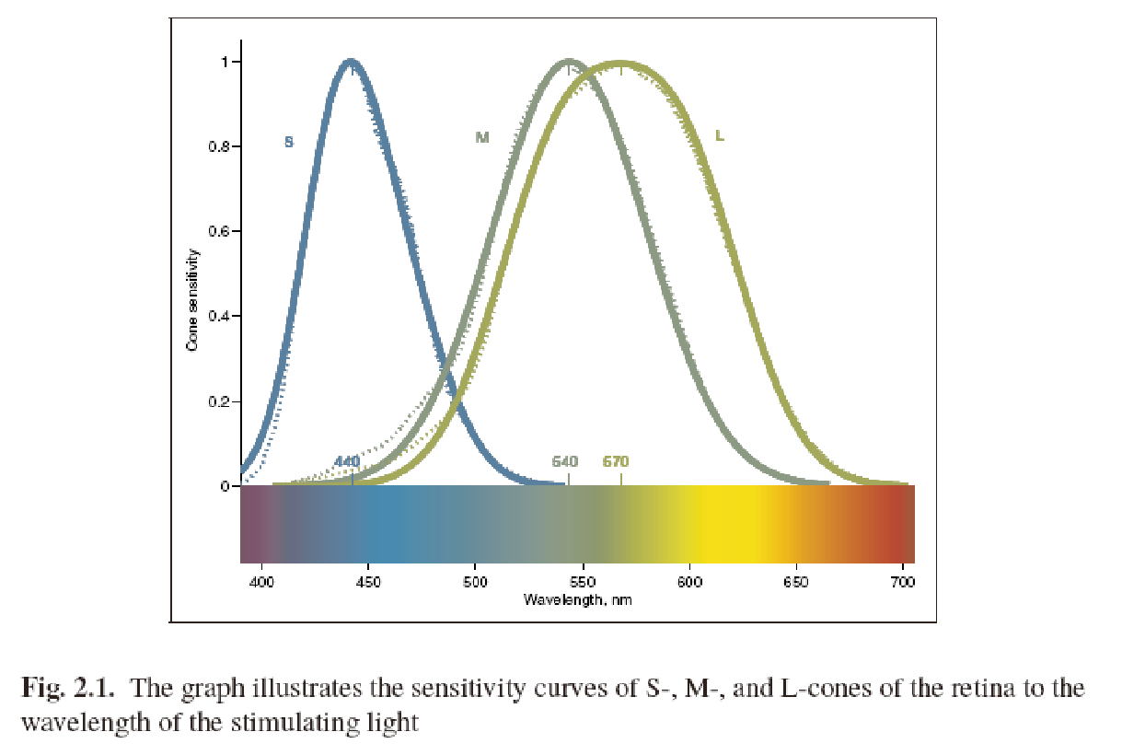
Cones:
6-7 Million for Color Perception

Slide 17
In the Brain How do we create a world model?
LGN extracts low level features, such as edges, boundaries, textures, colors, corners or lines.
Primary visual cortex, called V1,
extracts a map of spatial information about the relative location of objects.
highlights what is important from visual inputs to guide the shifts of attention known as gaze shifts.
V2, V3, V4, V5 generates high level vision information

Slide 18
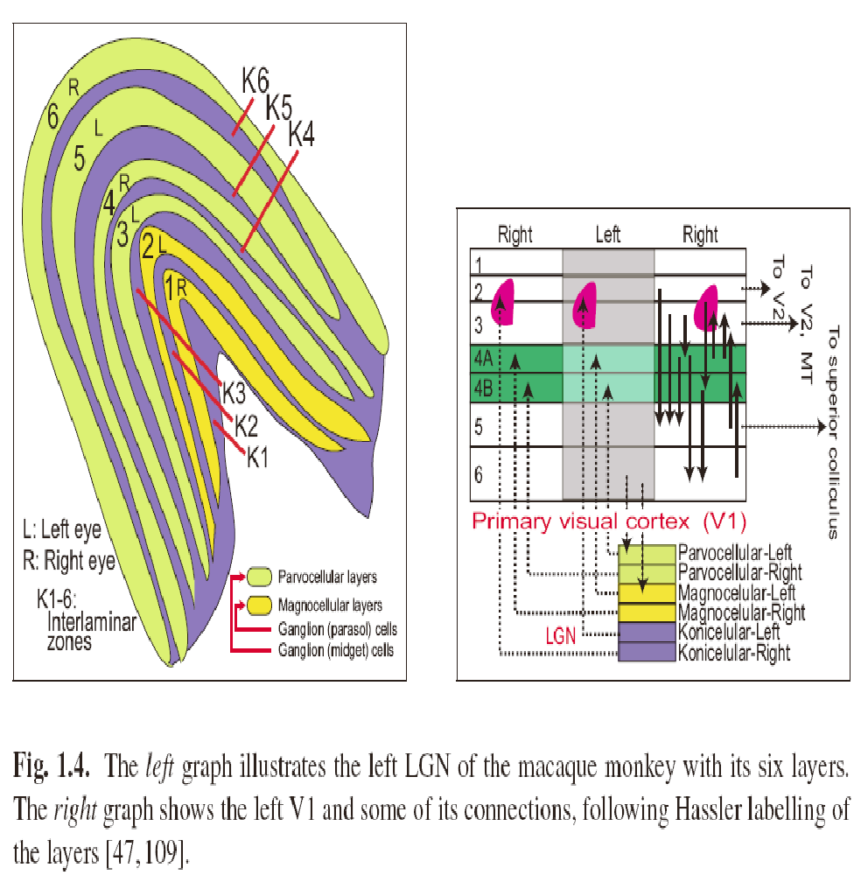
Lateral Geniculate Nucleus of Monkeys
Notes:
Monkeys LGN has 6 layers

Slide 19
Vision Theories
Emission Theory: “Eye emits light and the light interacts with object” Euclid, Ptolemy
Intromission Theory: “Shape of the objects enter the eye” Aristo, Galen
Two eye Theory: “Light, reflected from the objects enters to the eye. This reflection enables us to see” El-Haytham
Marr Theory: D. Marr
Gestalt Theory: K. Koffka, M.Wertheimer, K. Köhler
…

Slide 20
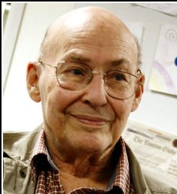
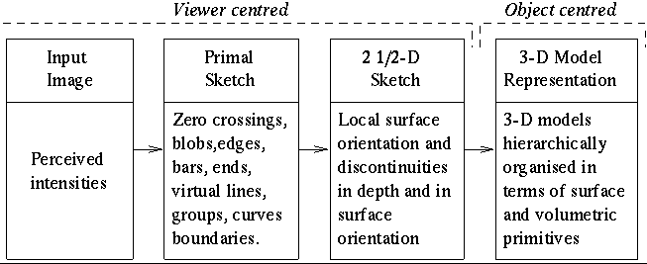
Marr Theory (1970): Visual System is a hierarchical, modular and decomposable computing system
Learning
(Poggio)

Slide 21
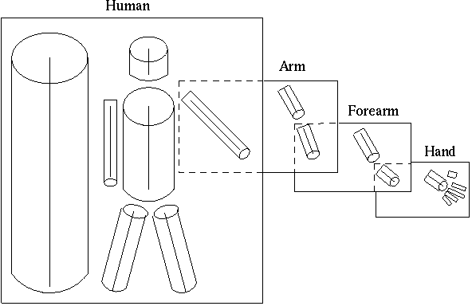
First computational model for vision : Marr’s 3-D model output
http://homepages.inf.ed.ac.uk/rbf/CVonline/LOCAL_COPIES/GOMES1/marr.html

Slide 22
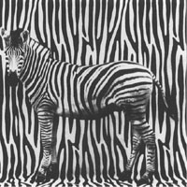
Problems with Marr Theory
In reality
Hierarchical modules are not independent of each other
Vision is not a bottom up process.
Vision is not independent of other cognitive processes, such as memory, reasoning etc.

Slide 23
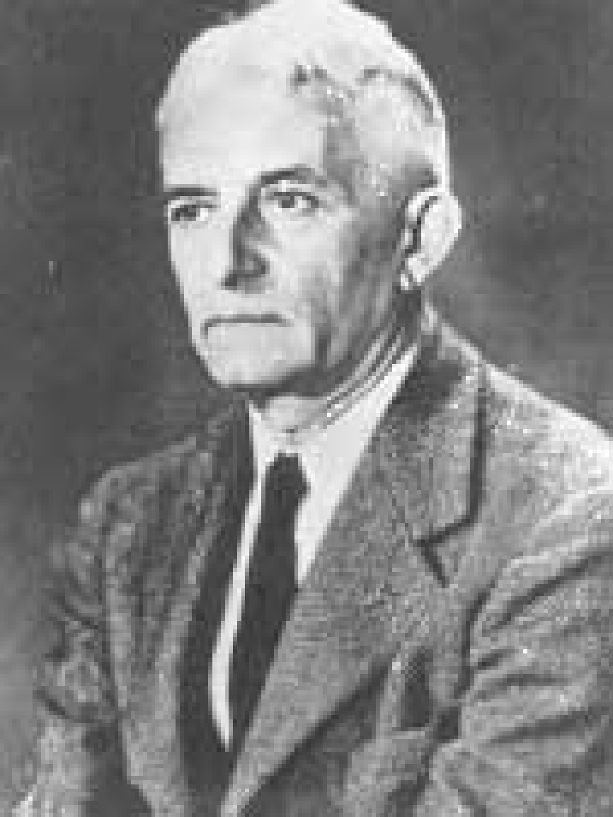
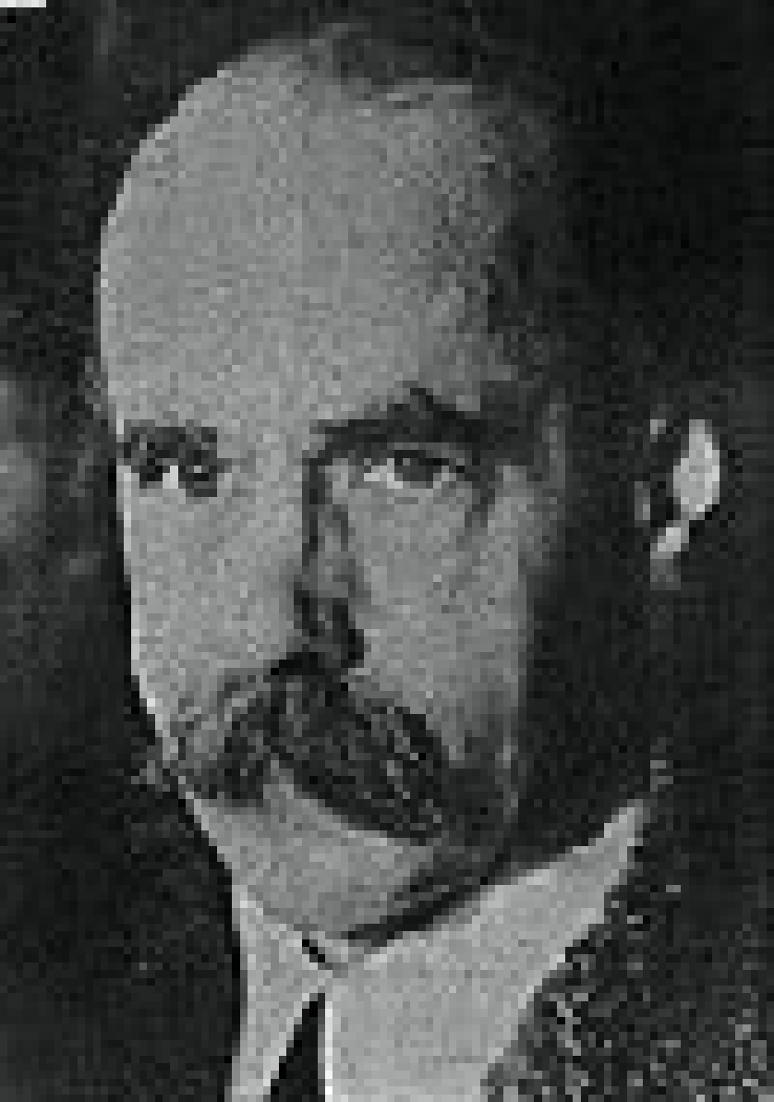
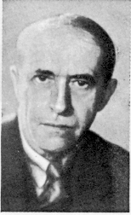
Gestalt (shape) Theory
Vision is the product of the interactions between output stimuli and human brain.
Wolfgang
Köhler
Max
Wertheimer
Kurt
Koffka
© Stephen E. Palmer, 2002

Slide 24
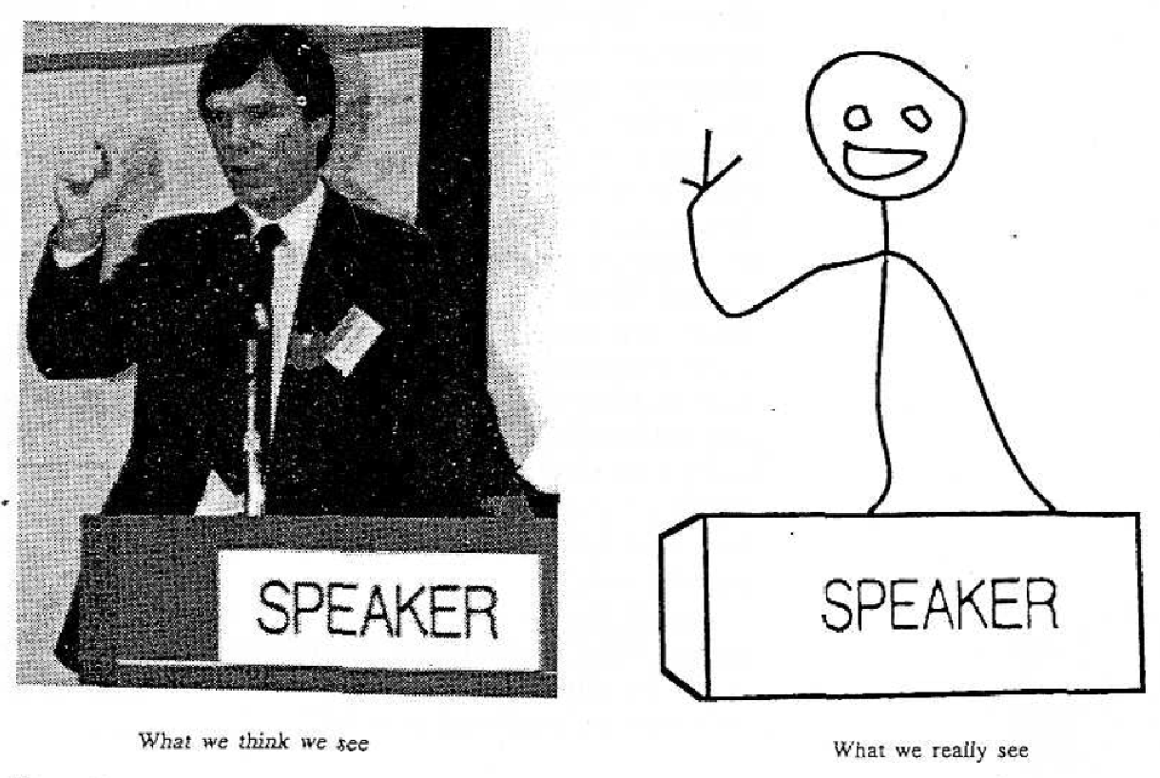
Gestalt Theory
Whole is bigger than the sum of its parts.
We unify and simplify the small parts. Therefore we perceive these simplified objects.

Slide 25
Vision Loop
Bottom-up
- Vision start by the reflection of light from the environment
- Ends by meaning
Top-down
Vision stars by a cognitive process in the brain
Perception comes from the expectations and priori information in memory
Notes:
IM: Activity Handout 5.1: Is It Top-Down or Bottom-Up?

Slide 26
Gestalt Rules
Relationship between object and background
Proximity
Similarity
Closure

Slide 27

Rule 1: Relationship between object and background
Object is important. Background is just to see the object
We draw imaginary boundaries between object and background
This imaginary boundary belongs to the object

Slide 28
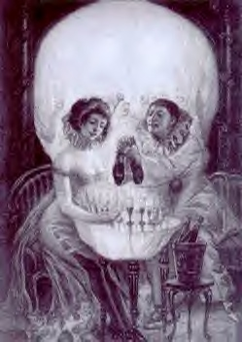

Discrimination of the object and background is a serious cognitive task
Not mu? öğrenme mi?
Aşk mı? Ölüm mü?

Slide 29
We do not see the object, we just see the difference between the object and the background

Slide 30
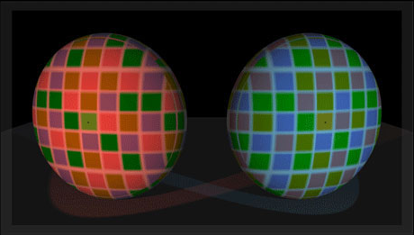
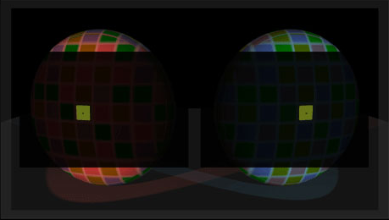
We do not see the colors, we just see the difference between the adjacent ones
http://www.lottolab.org/Visual%20Demos/Demo%2015.html

Slide 31


Rule 2: Proximity
Close objects has a tendency to be a part of a whole.

Slide 32


Rule 3: Similarity
Similar objects are likely to be a part of a whole

Slide 33



Rule 4: Closure
Even if it is incomplete or broken our brain makes it whole
We try to reach the whole in our mind by completing the missing parts.

Slide 34
Problems with Gestalt Theory
It is not a complete theory
It is based on our partial observations
There is no computational model for Gestalt Theory

Slide 35
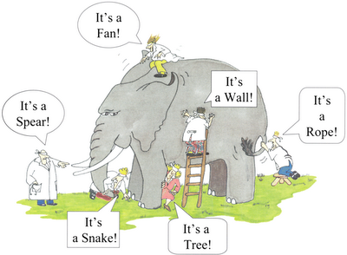
Which one of these theories are correct?
None
Why do we have to know these theories?
In order to develop image processing and computer vision models.

Slide 36
CHARACTERISTICS OF HVS
RESOLUTION: Ability to separate
Two adjacent pixels: Spatial Resolution
Two colors: Radiometric resolution
Two frames: Time resolution

Slide 37
Response of HVS to resolution depends on various factors
the amount of luminance
(measured in Lambert, 1 L= 1/π candela/cm2),
distance of an object from the eye,
the current brain states,
health conditions,
the genetic properties of a person,
etc.

Slide 38
1.Spatial resolution
Low frequency High frequency Very High frequency
f=2 f= 4
x direction
Spatial Resolution is restricted by physical size of rodes and cones, which is an important factor to determine the sampling rate of image

Slide 39
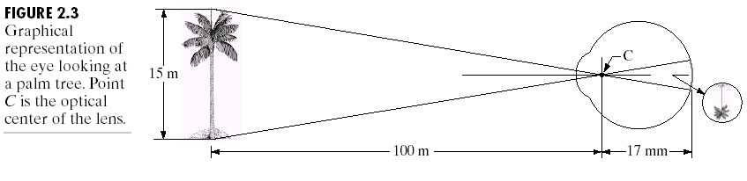
Spatial resolution depends on the distance of the object from the eye
Field of viev

Slide 40
2. Radiometric resolution: Response to intensity and color
Pupil changes size according to the brightnes level
What you see is different than what it is
dark
Glare limit
quantization

Slide 41
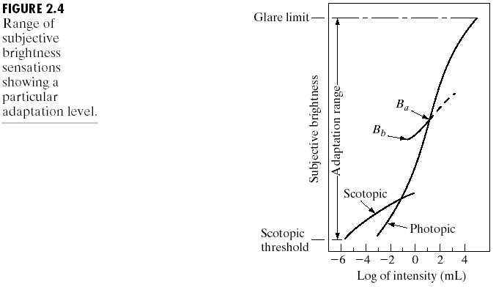
Brightness adaptation is logarithmic function of intensity

Slide 42
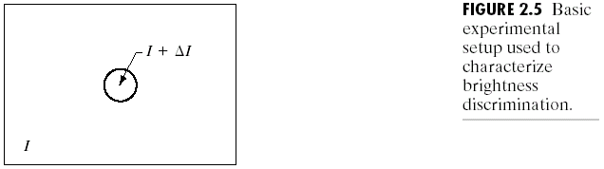
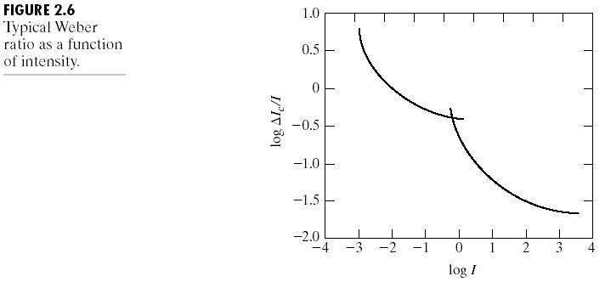
Weber’s law: weber ratio = ΔI/I
I: intensity, ΔI: increment of discriminable illumination
rodes
cones

Slide 43
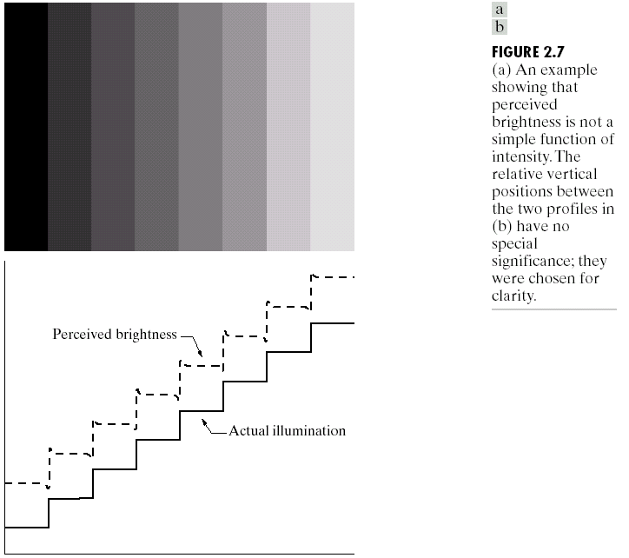
MACH BAND EFFECT (Ernst Mach)

Slide 44
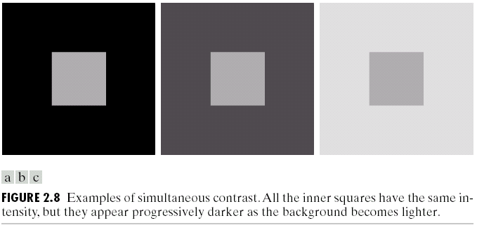
Simultaneous Contrast: Background effect the color of the object

Slide 45
3. Temporal resolution: Response of HVS as a function of time
Flicker frequency: ability to observe a flicker
Depends on the brightness: 50 hertz

Slide 46
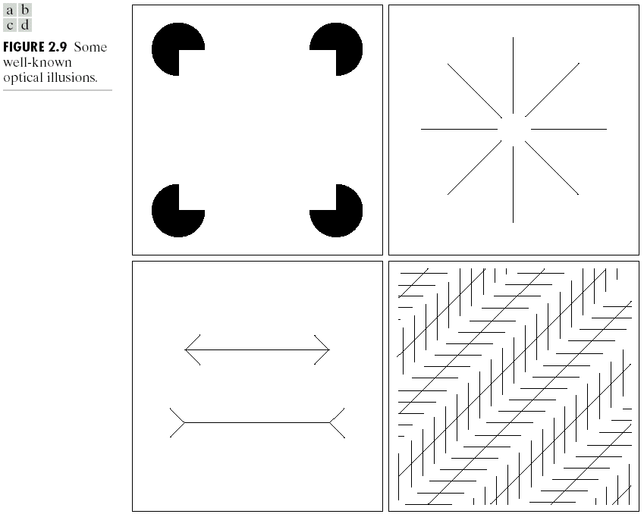
Visual Perception- Illusions

Slide 47
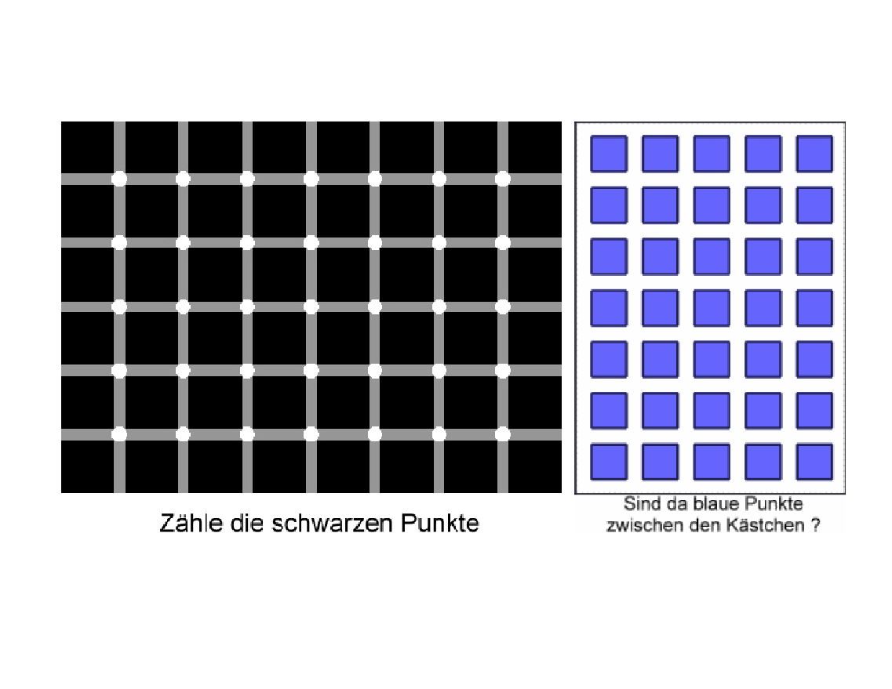
Simultaneous Contrast

Slide 48
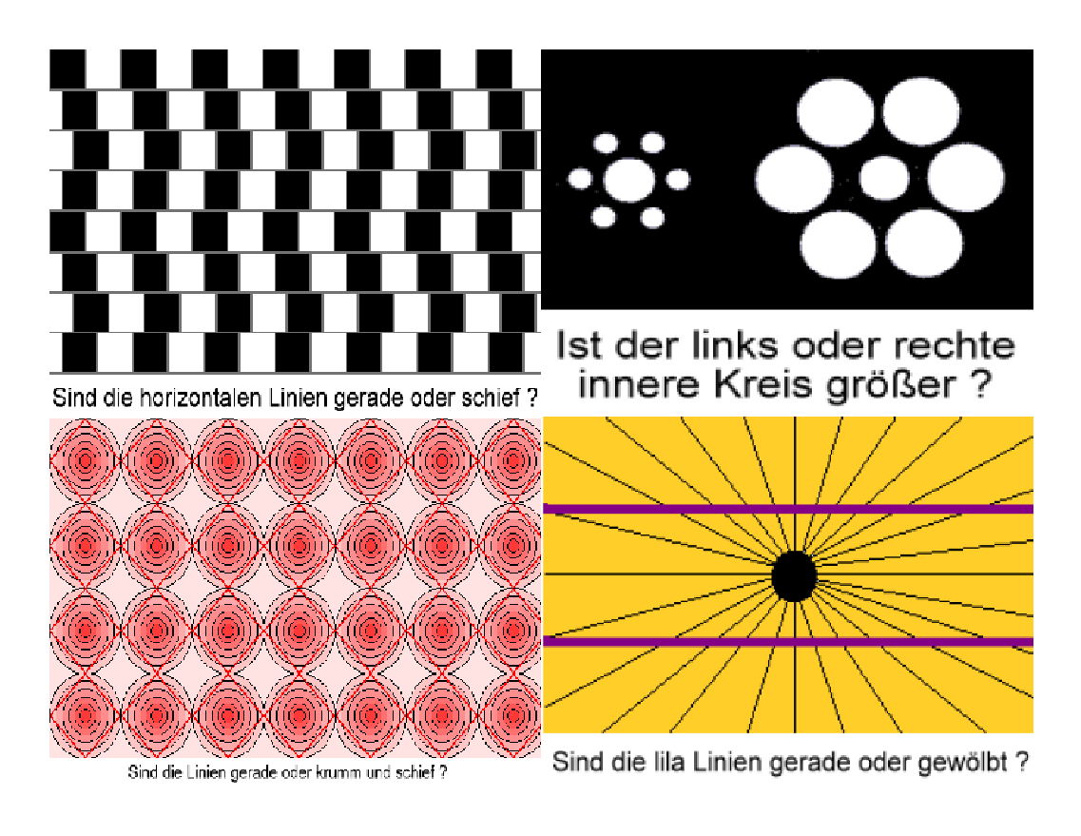
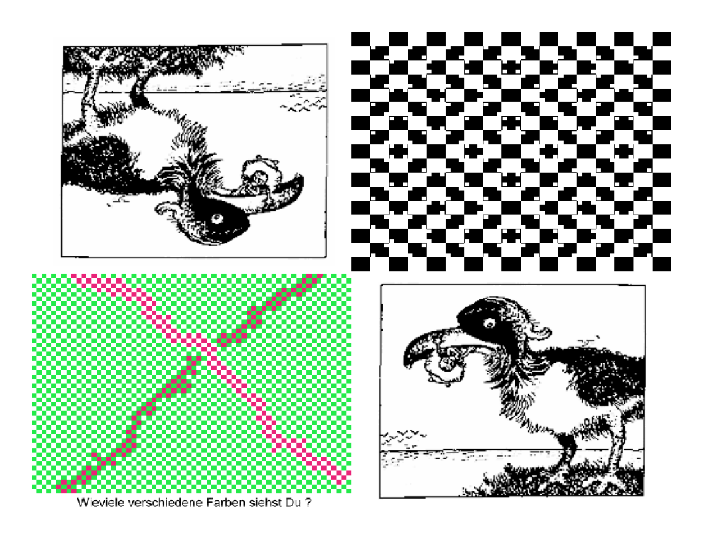

Slide 49
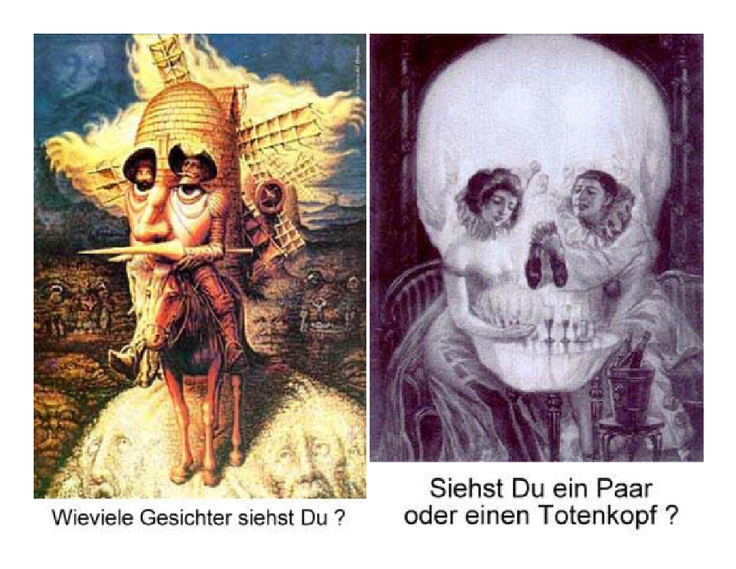

Slide 50
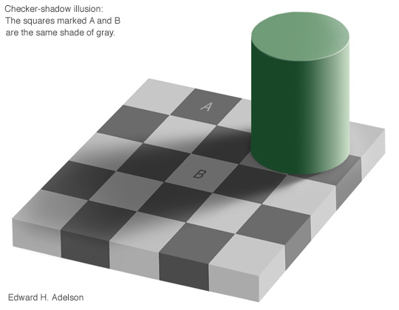
HVS: Visual Illusion
From Prof. E. H. Adelson

Slide 51
HVS: Visual Illusion
From Prof. E. H. Adelson

Slide 52

HVS: Visual Illusion
Which lines are straight?

Slide 53
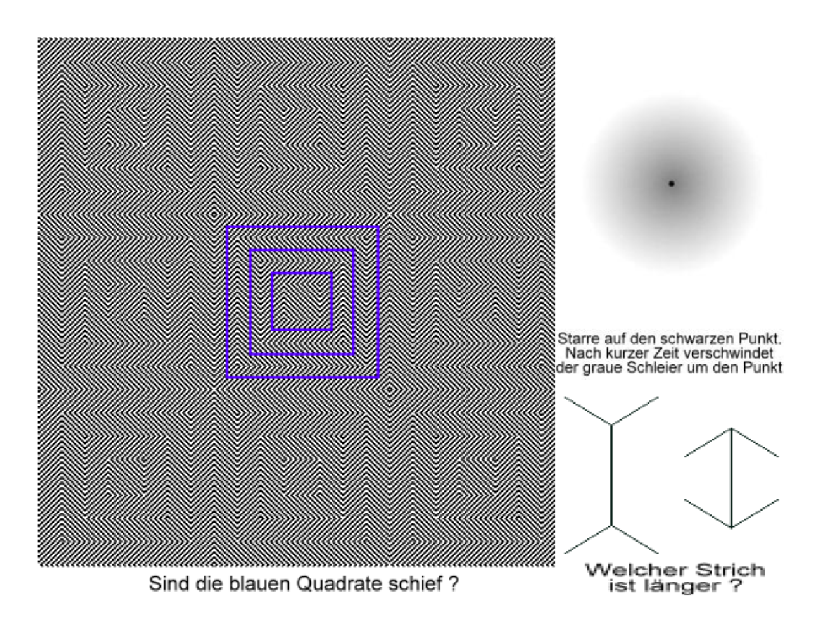

Slide 54
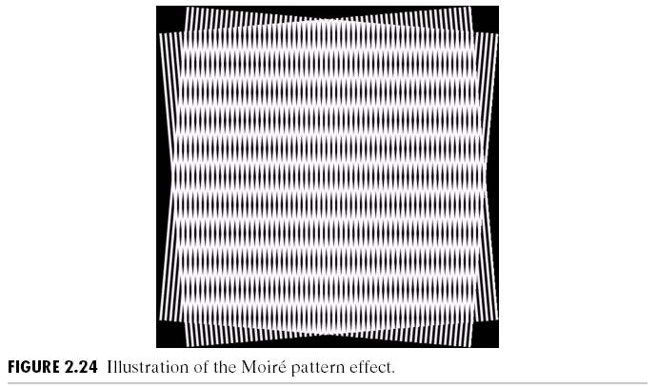
Moire Patters

Slide 55
Image acquisition devices (Obtional)
Three types
Single sensor (scanners)
Sensor stripes (xerox, tomography), circular sensor stripes
Sensor arrays (cameras)

Slide 56
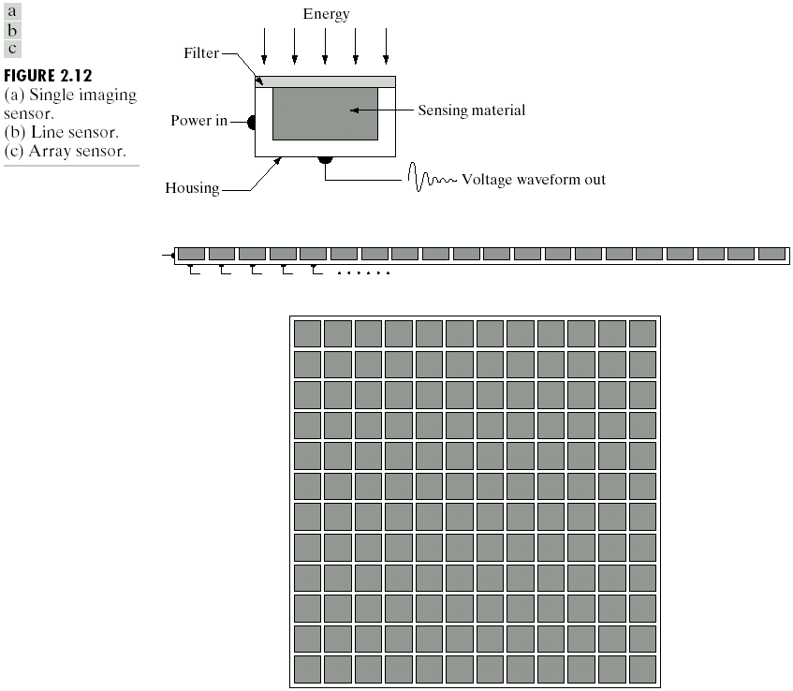
İmage acquisition: convert light to electrical signals

Slide 57
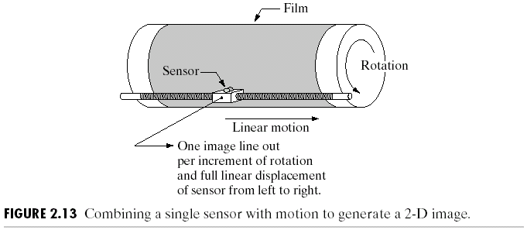
Chapter 2: Digital Image Fundamentals

Slide 58
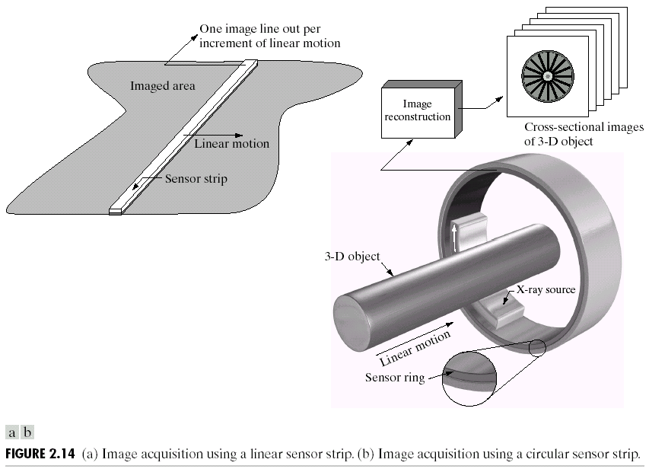
Chapter 2: Digital Image Fundamentals

Slide 59
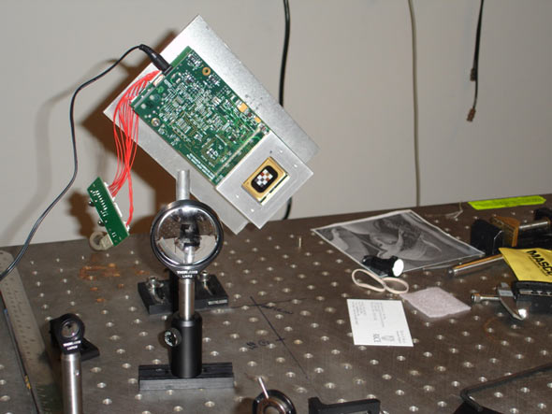
Emerging technology: Single pixel camera
Compressive sensing

Slide 60
https://www.youtube.com/watch?v=hcvypLIRmxg
https://www.youtube.com/watch?v=auJJrHgG9Mc

